Slide 1
Welcome to the ABC’s of Kindergarten!
Mrs. Flowers
HPCS
2023-2024

Slide 2
Welcome to Kindergarten!
I am so excited to be your child’s teacher. I look forward to getting to know you and your little one this school year!
About me… I have been married for 18 years and I have 5 wonderful children affectionately known as
The Fab 5.
I am a graduate of MTSU with both my bachelor’s in Early Childhood Education and Family Science, and my master’s in Administration and Supervision. Occasionally I teach a night class at the University. I have been teaching since 1997.

Slide 3
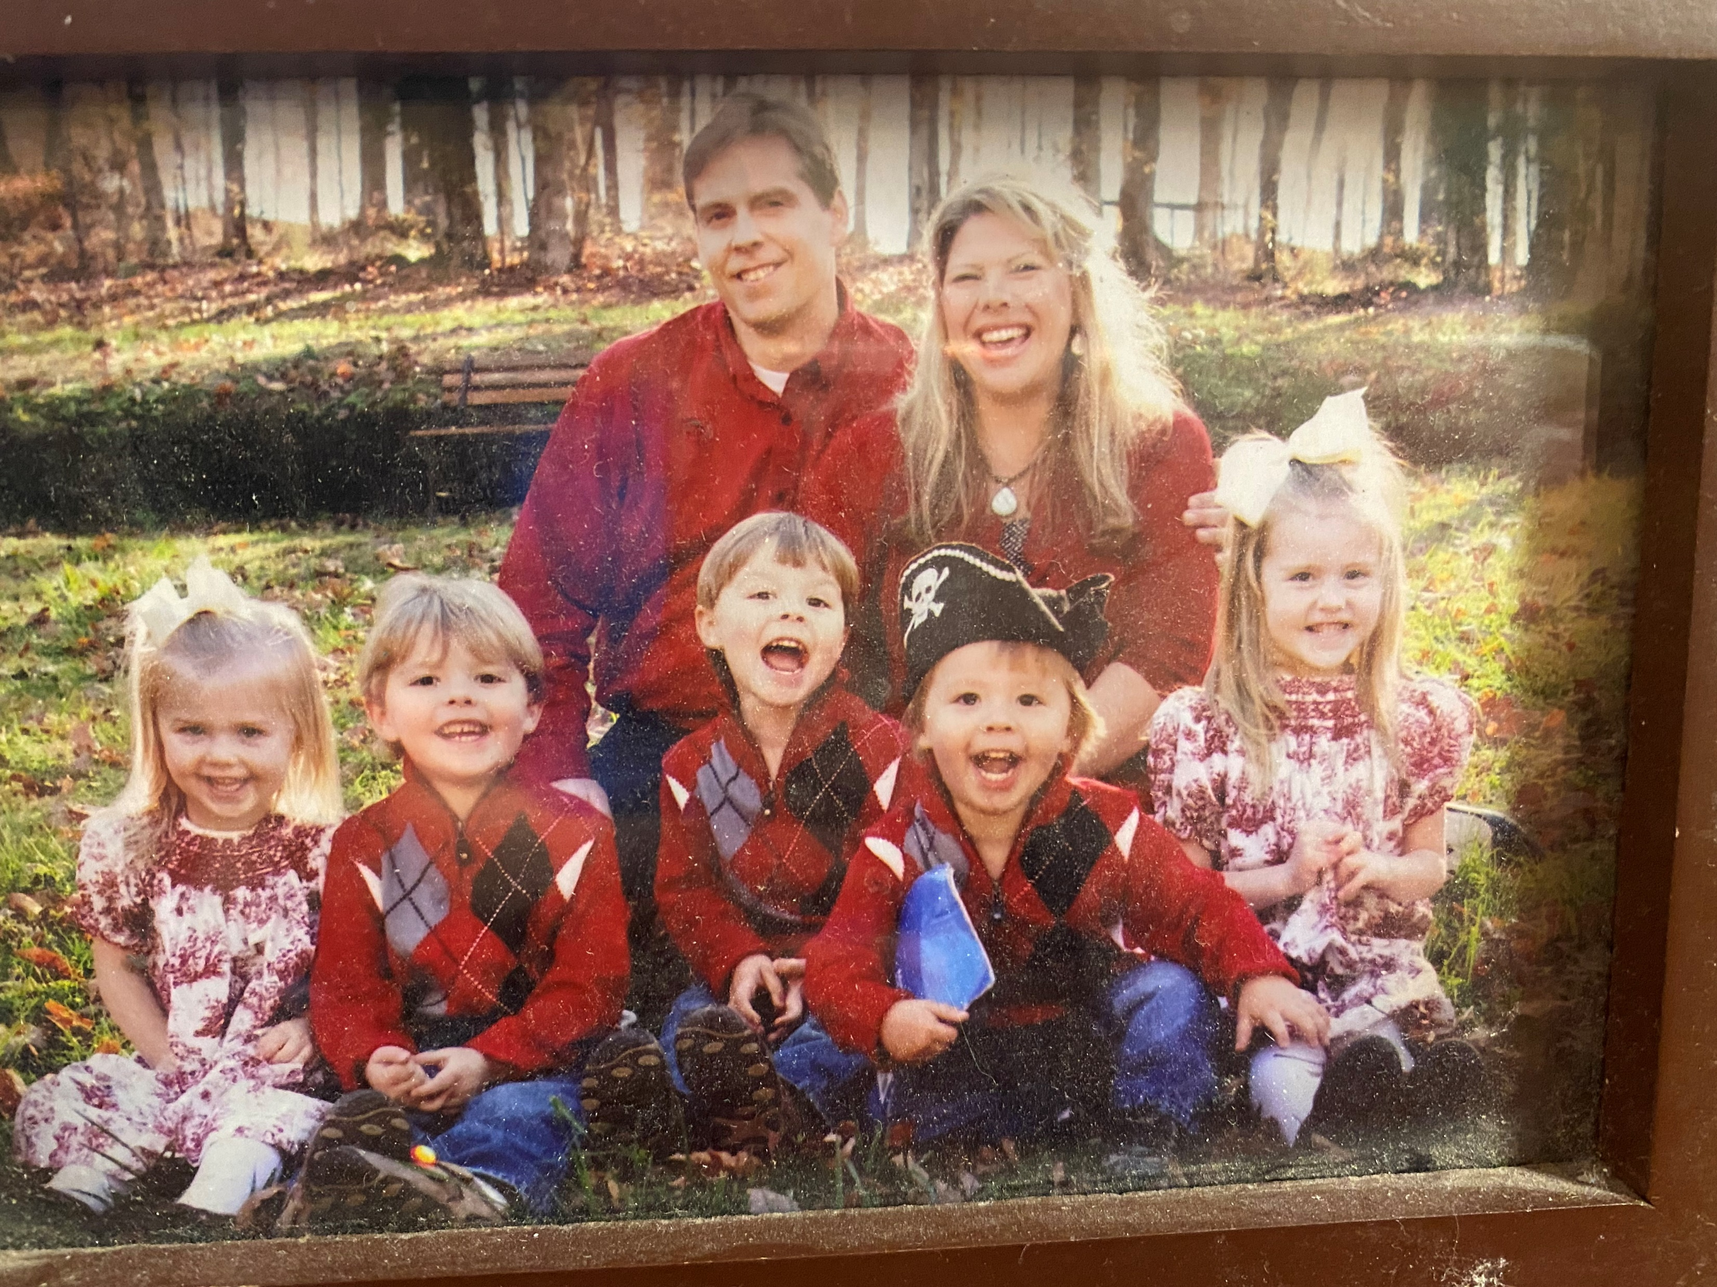

Slide 4
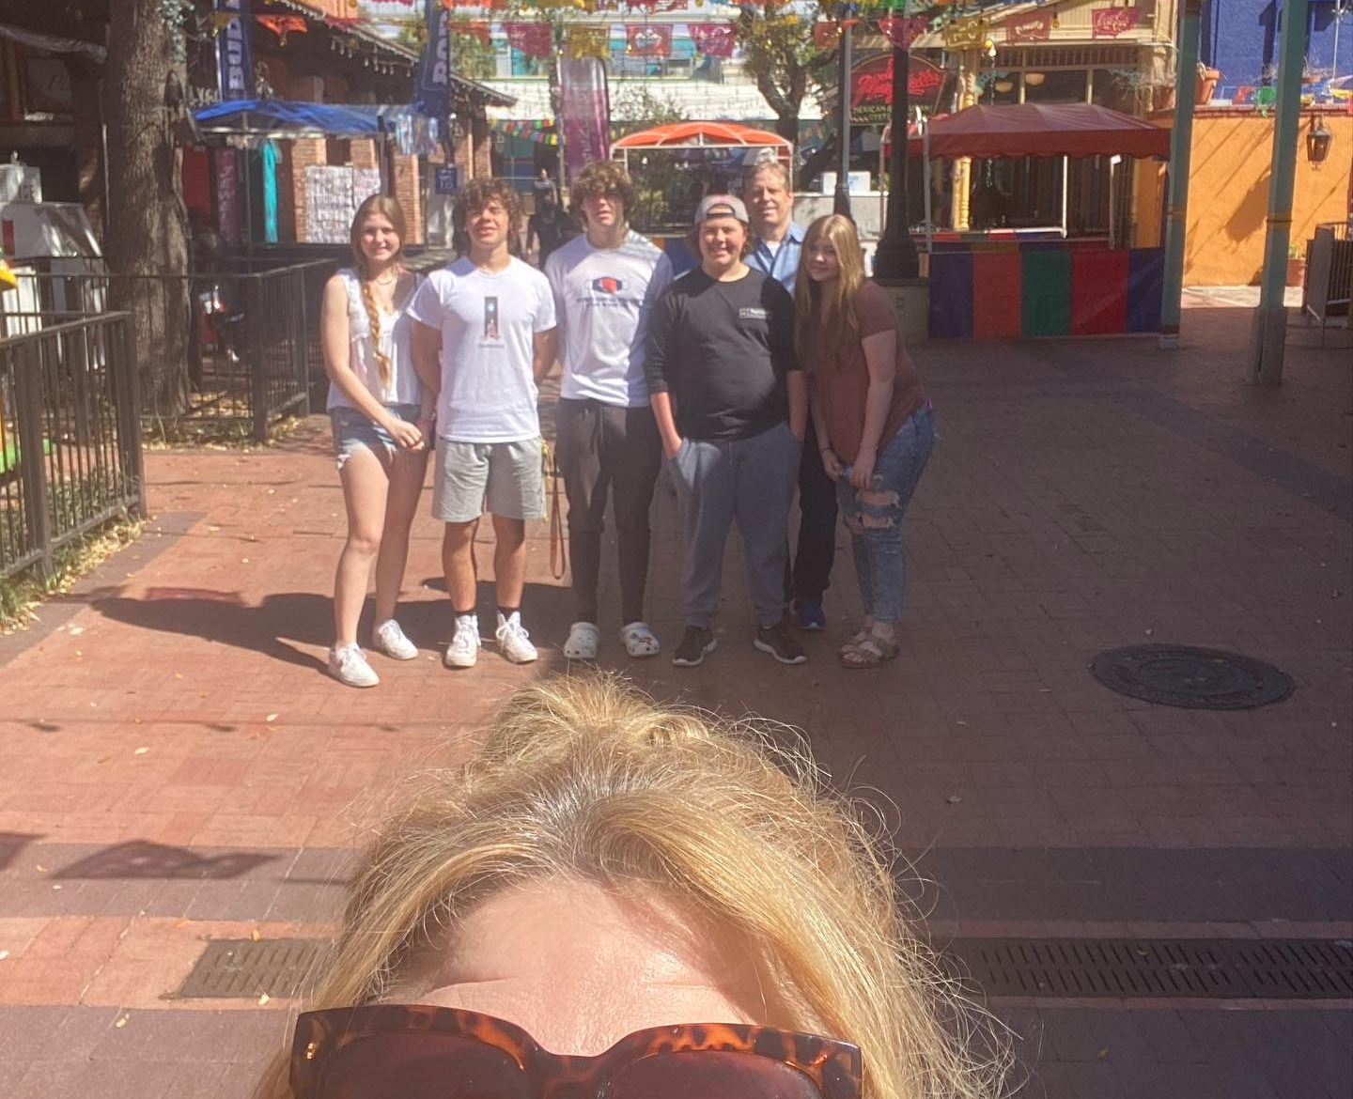

Slide 5
A- Attendance, Absences, and Allergies
*Good attendance is linked to school success!
*The doors to the school open at 6:50. Students will get breakfast and/or go to Lightening Leader Clubs until 7:15. Students will be dismissed to class at 7:15. Students are dismissed to class at 7:20 where they will go to play centers to start their day. The tardy bell rings at 7:30. Upon arrival to the classroom students will go directly to play centers. Those centers close directly after announcements.
*Students will need to get a tardy slip from the office to enter class late.
If your child is sick or you know he/she will be tardy, please call the office at 615-895-1030 or email Mrs. Flowers and Mrs. Wilson @ flowersm@rcschools.net and wilsonk@rcschools.net .
*Your child’s attendance is vital to their success in Kindergarten. If your child is out sick I will do my best to send home make up work, however, so much of what we do in class is hands on learning so it often impossible or far less effective to make up that experience with a worksheet.
* We do have food allergies and sensitivities in our classroom. Please avoid sending in peanut products and high sugar foods for snacks.

Slide 6
B-Breakfast, Birthdays, Bugs, and Book Orders
Breakfast is served from 7-7:15 and costs $2.00.
Celebrating a birthday is such a special time. If you would like to celebrate at school, please purchase ice cream and students will be served at lunch. Since both kindergarten classes share a close friendship, it is encouraged that birthdays are celebrated with both classes. Both kinder classes eat lunch at the same time. We will not be distributing cupcakes at school. Please contact Mrs. Connor with questions (connorm@rcschools. Net) Ask me about sending in ice cream. ☺
Our students develop strong friendships across both classrooms and we have lunch at the same time so it is encouraged to celebrate birthdays with both classes. We have 38 students in kinder.
If you are hosting a birthday party for your child and not intending to invite the whole class, please refer to the school directory to mail the invitations to the invited guests. This avoids hurt feelings. The directory will be published shortly after the start of school.
BUGS- We go outside each day, weather permitting. In the summer and spring months we often have issues with mosquitos. If you would like to send in a bug bracelet for your child to wear while playing on the playground please feel free to do so. We can keep it in your child’s cubby when it is not being worn.
Book orders will go home monthly and are a great, inexpensive way for you to build your home library as well as contribute to our classroom library. You can either send your order in to school or make your order online at Scholastic.com. More details will be coming home soon!

Slide 7
C- Curriculum, Class meetings, Clothing, Chickens, Cleaning & the Circus
Our curriculum can be found here.
We hold a class meeting each morning. This is very important to the success of our classroom as we are setting the tone for our day as well as working hard to build our classroom family. The children will be working cooperatively, sharing ideas, and getting to know each other better every day.
Please send in a complete change of clothes for your child to keep in their cubby in case of accidents and/or spills. I will send it home in November to be changes out to winter clothing and again in March to be changed back to spring clothing. Flip flops are not allowed to be worn at school by students. To participate in PE your child will need to wear tennis shoes. You are welcome to keep an extra pair in your child’s cubby in case they forget and wear the wrong shoe to school. Also, please label your child’s jackets/clothing.
We take care of our chickens daily. The children will learn to handle them and the eggs appropriately. We wash our hands after every visit.
The classroom will be wiped down with disinfectant at the end of each day. We sanitize throughout the day with Clorox wipes and we welcome any donations you can make.
The circus is an annual tradition here at CS. In fact, this year we will be hosting our 45th circus! It is an event you DO NOT want to miss!

Slide 8
D- Dismissal & DAISY books
Dismissal begins at 2:25. Dismissing early for the day does count as a tardy.
Children will not be released to a parent or adult without the tag. If yours is missing we will send you to the front office to pick your child up there.
If you are changing transportation please email Mrs. Wilson and myself at wilsonk@rcschools.net and flowersm@rcschools.net.
Please avoid getting out of the car during dismissal. We try to move the line as quickly as possible. Have your child practice buckling their seat belt on their own.
The DAISY book is our primary means of communication outside of email. Please check and initial it every evening for notes and information regarding your child’s school day. It is a valuable resource for you.

Slide 9
E- email and events
flowersm@rcschools.net
I try to check my email periodically throughout the day. I will try to respond tot your message as quickly as I can.
PLEASE make sure I have your email address as well! I send out lots of updates and reminders and If I don’t have your information you will miss something!
We have lots of fun events taking place. I will notify you in advance in hopes that you can participate. A sign up genius will be sent out for participation as well.
F- friendship and field trips
We will be working hard on making friends and keeping them! You can help at home by encouraging your child to be patient and kind and using their words, rather than their hands, when they are unhappy.
We have several great field trips in the works this year that you won’t want to miss! When you receive a field trip permission slip it is very important that you fill it out and return it as soon as possible. Permission slips can not be accepted after their due date. Please make sure any money for the trip is in a sealed envelope with your child’s name on it or paid online through the cash ap.

Slide 10
G-Good behavior
The children are expected to follow the school and classroom rules. The expectations for behavior are outlines on the fuzzy/rainbow page. I will notify you if a problem arises.
Gym- our classroom is located directly under the gym. The sound of the children playing often sounds like thunder. If your child is sensitive to that you may want to prepare them in advance.
H- Homework
We will have monthly homework assignments most months. Those will usually be a project that goes along with something we are doing in class. The list of family homework assignments and dates can be found on our class website.
In a few weeks we will start our official reading homework which is Raz Kids. It is an online reading program that the children will read from nightly.
Other homework may be given periodically, as needed, but not on a regular basis.
Homework will rarely be given outside of the family homework assignment for the month. If your child brings work home, it is most likely work that was not completed in class, or it is work that needs to be corrected.

Slide 11
I- Ice cream & Independence
* Ice cream can be purchased from the cafeteria on Fridays only for $2.50.
*Kindergarten is a year of growing independence! Your child will learn to do many new things on their own. Encouraging them to dress and undress themselves, opening their water bottles and milk cartons, buckling their seatbelts and tying their own shoes is a big deal and a great way to start fostering some of that independence.
J-Jobs and Journals
The children will all be responsible for various jobs throughout the classroom to help our classroom routines move smoothly.
Your child will be journaling daily. During conferences I will share some of their writing with you. It is always fun to see how your child grows as a writer through the year. In Kindergarten it is also appropriate to use invented spelling, or phonetic spelling, so please do not worry if the words in the journal are not spelled correctly.

Slide 12
K- Kindness
Be Kind….always! Kindness counts! We will work very hard to be kind to each other everyday.
L-Lunch
Lunch is at 10:45-11:15 daily. The cost is $3.25 for students.
Dr. King will publish a sign-up genius for parents to come to school and eat lunch with the children occasionally.
Students will eat in the cafeteria each day. They may buy lunch or bring it from home.
Please send in lunch money in an envelope with your child’s name on it or use the cash ap on the district website.
A-la-cart items are available; however, kindergarten does not partake of those.

Slide 13
M-Messy, Math, Mystery Reader, & Marvelous Me
Kindergarten can be messy, dress your child appropriately. Please keep a change of clothes in a labeled bag, in your child’s backpack.
Our Math block 112:40-1:40 each day. We will be doing lots of hands-on math this year as the children increase their knowledge of numbers, money, and shapes!
We will have Mystery Readers this year! A link to sign up will be going out soon so be watching for an opportunity to volunteer!
Marvelous Me- This is your child’s week to stand out as our special person. There is a “MM” schedule, as well as information outlining the details in the DAISY book.

Slide 14
N-Newsletter & Naps
In an effort to conserve paper use, newsletters will be sent via email. Newsletters will always be posted to our website.
We do have rest time daily. Please send in a rest mat and a crib sheet or beach towel to cover the mat. I will return the crib sheet on Fridays for washing. Please send it back on Mondays.
O- Office
The number to reach the office is 615-895-1030
If you need to pick up your child early, stop at the office and sign your child out. The office will call us over the intercom to be dismissed to you.

Slide 15
P-Parties, Pets, Project Based Learning & PTC
We will have several celebrations this year. The sign-up genius for these events can be found here and on our class website.
That is your opportunity to be involved! Our room mom will contact you to coordinate how you can help!
We have several pets in our classroom. We have a blind hedgehog named Mr. Prickles, a bearded dragon named Francisco, and 2 very special bunnies, Butter and Tubby. Your child will help care for them throughout the year and they are very important aspects of our classroom. During holidays and extended breaks you will have an opportunity to “adopt” them for the time out of school.
Project Based Learning- I believe children learn when learning is made meaningful. I will be providing your child with many different experiences this year through our PBL’S. Some of which include local farm tours and then bringing home what we learn and applying it to our own back yard… our playground!
Please check out our PTC! It’s a great way to get involved in what’s going on at Campus School and they would welcome your participation! The PTC will be giving your child a free Legacy shirt so you will not need to order one from the online store. An officer will also be in attendance at the BOO HOO breakfast on Monday if you have any questions about the PTC.

Slide 16
Q- Questions
Dr. King (principal) kings@rcschools.net
Dr. Perry(assistant principal) perrya@rcschools.net
Mrs. Wilson (attendance) wilsonk@rcschools.net
Mrs. Leffingwell (school bookkeeper) leffingwelll@rcschools.net
Mrs. Ingrum (school reception) ingruma@rcschools.net
Mrs. Flowers flowersm@rcschools.net
R-Related arts schedule
8:30-9:10 Monday- PE, Tuesday Art, Wednesday- Music, Thursday-Art, Friday- Music and Movement or Work out room/True Blue Store
12:00-12:40 Monday- Music, Tuesday Guidance, Wednesday PE, Thursday Library, Friday-
Music and Movement or Work out room/True Blue Store

Slide 17
R- Report cards, Room moms, Reading and Rainbows
Report cards go home each 9 weeks. Progress reports will go home midway through the 9 week period. Official conferences are held twice a year, but we can definitely meet if a need arises.
Room mom- Please sign up or see me if you are interested in being the room mom.. I can answer any questions you may have. Last year we had a room mom team and it seemed to work out great! If you are interested, please sign up on the sheet provided.
Reading… please read to your child NIGHTLY. I know it can sometimes be a hard thing to squeeze in at the end of the day, but it is very important! Razkids is a helpful tool to make that happen. Your child will be a proficient reader before going to 1st grade!!
Rainbows- Your child will color a rainbow each day to indicate their behavior for the day. RED on the rainbow is NOT bad! That is our starting point each day. Some days may just be regular days and I didn’t happen to catch your child doing something OR, somedays I may just be too busy to remember the rainbow… it’s happened! If you are concerned about your child’s behavior, please mail me. If I have a concern about your child’s behavior, I will email you!

Slide 18
S- Supplies, Snack, Sign up genius, Social Media
Supply lists can be found on the website. Please make sure your child has a prepared school box in their cubby that is ready to go before you leave. It should have a box of crayons, scissors, a glue stick, a pink eraser, and 2-4 sharp pencils inside. Please place remaining supplies in the labeled bins in the hallway.
A snack calendar will be sent home in conjunction with the behavior calendar each month in the DAISY book. We do a class snack each day. If your child is scheduled for snack, please send it in on Mondays. Please send in enough for 19 students. Also, please send in the small waters instead of the large ones. They are much easier for our little hands to handle. Please try to stick to healthy snack choices. We have children with nut allergies and sugar sensitivities. Please avoid sending cupcakes and donuts.
We use sign up genius for most events and activities and the links will be emailed and posted on our class website for your convenience.
You can follow class events and snippets on Twitter at @CSFlowerpower and our youtube chanel.

Slide 19
T- Toys, Texts, & Time
Please do not send toys to school unless it is your child’s special item when they are Marvelous Me or they have earned a reward. If they have earned a toy reward, I will send you a note. Otherwise, toys need to remain at home.
Please sign up for text alerts. I will send home reminders through the remind app and you don’t want to miss anything! Directions are on our class website.
Time is very important and valuable in kindergarten! We move at a very brisk pace all day. You may find that your child will do better with an earlier bedtime in the school year.
Also, because my teaching time is so valuable, I am not able to chat or conference with you during class hours. If you need me, please send me an email and I will get back with you asap!
U- Umbrellas, University Students & Underwear
Please do not send in umbrellas.
We will have several Residency 1 candidates from the university in our classroom directly working with the children. When we are assigned a new student, I will make sure to send home info about them so that you are aware that they are here. We also will have other students here observing throughout the semesters.
Please include extra underwear in your child’s bag of extra clothes. Also, I will send home the clothes as the seasons change so that you can send in weather appropriate clothing.

Slide 20
V- Volunteers
Volunteers can be scheduled in advance starting in September. Volunteer hours are only on Tuesday and Thursdays. When volunteering please make sure you wear your badge while in the building and only visit the classroom you are signed in to visit. If you would like to volunteer, please let me know via email the days and times you are available. I will get back with you to confirm.
Other ways to volunteer can be found here.

Slide 21
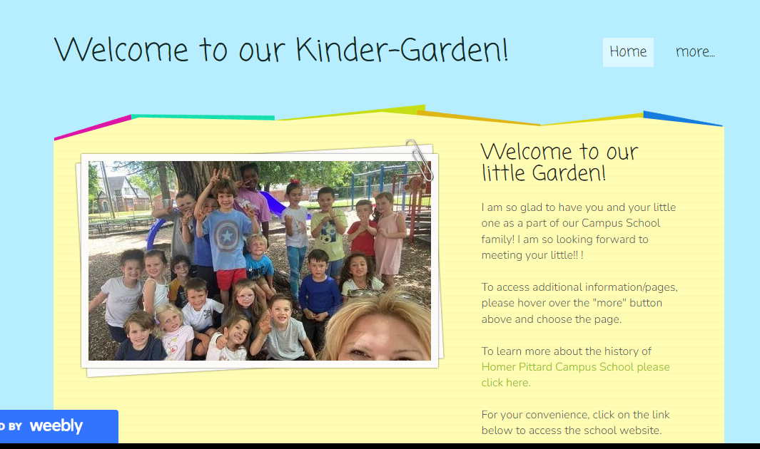
W- Daily Work & Website
A lot of our daily work will be kept in various journals in the classroom. However, on Fridays your child will bring home a Friday Folder. It will have the loose work that is yours to keep. Sometimes I will include notes on the work or suggestions to correct it at home. Once it’s corrected send it back to me, I will check it and then it’s yours to keep. Please return the Friday folders on Monday.
Please visit our class website to stay connected. https://mrsflowerskinder-garden.weebly.com/

Slide 22
X- eXiting !
Kindergarten is the most exciting, magical year!
We have a lot of fun!
Y- Yawns
Kindergarten is also exhausting! Please make sure your child gets plenty of rest each night!
A good breakfast each day will keep your child alert and ready to learn while they are at school.
Z-
Zippity Do Dah, we will have a wonderful year!!!

